Slide 1

Python Fundamentals
Innovation Masters
Day 7

Slide 2
Today’s Agenda
Meet and greet
Finishing while loops
Understanding for loops
Using for loops on Strings

Slide 3
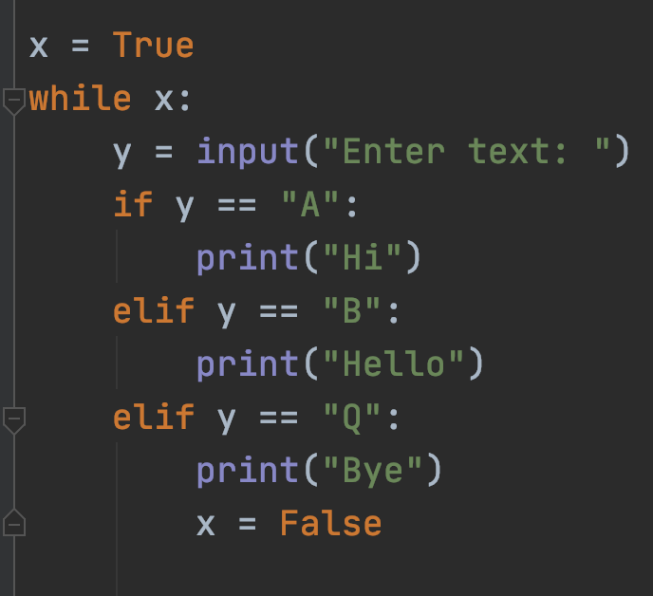

while loop using boolean
Short for x == True
A Boolean is a variable that only stores True or False
Every time we use a condition, we are essentially using Booleans
We can make continuous loops for running menu programs

Slide 4
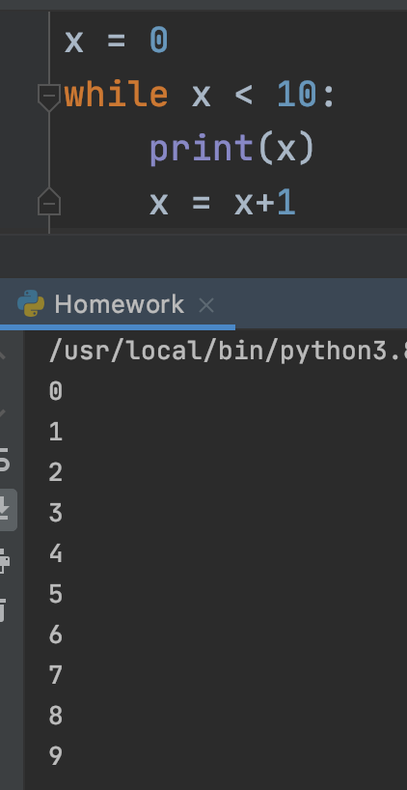
While loops continued
We have already seen how to use while loops using Booleans
Now we will use an integer to keep repeating the loop

Slide 5
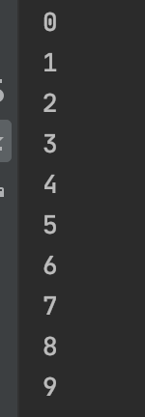
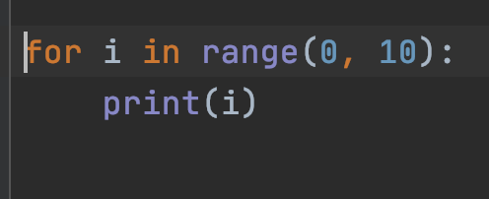






for loops
Starts with the first number in range, ends before the last
Here, 0-9, i < 10
Key word Iterating Variable Range
Output
Body

Slide 6
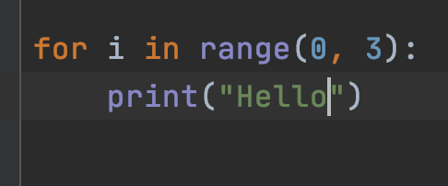
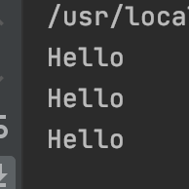
Another example
Simply repeating whatever is in the body of the loop 3 times

Slide 7
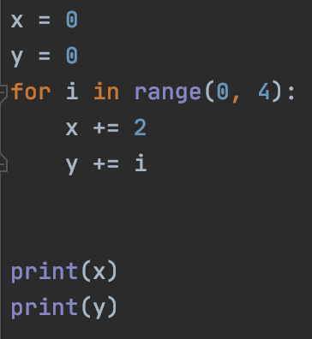

Updating variables
0, 1, 2, 3

Slide 8
Indices of string
Strings are a collection of characters like we said before.
Each character has an index number.
Index numbers start from zero
Let’s look at the index method

Slide 9
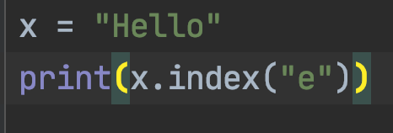
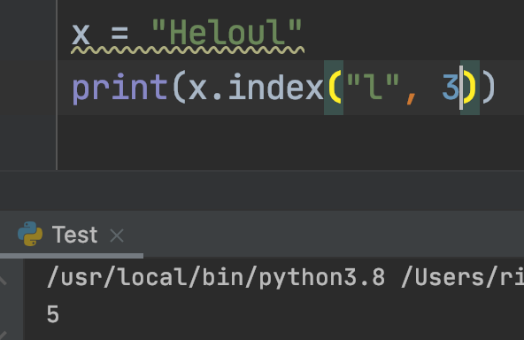
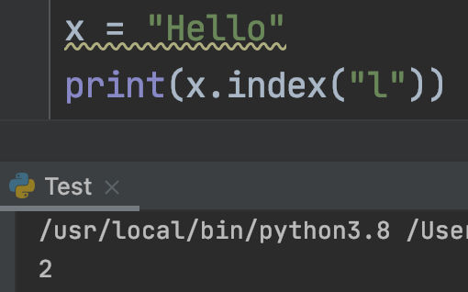
Index method
1

Slide 10
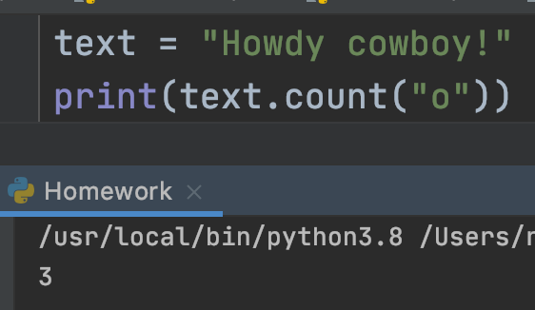
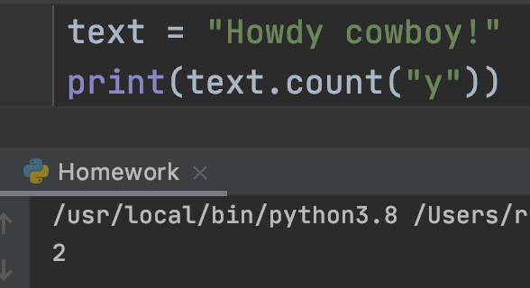
Count Method

Slide 11
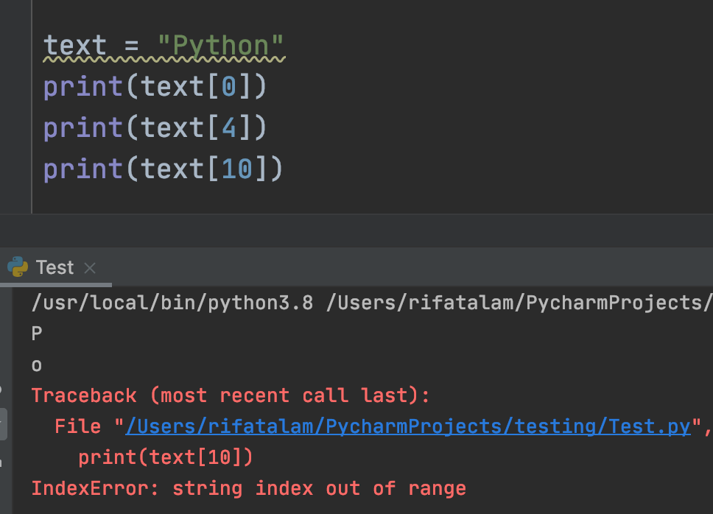

What is in each index of a string?
Opposite of index method, we can find what is the character in any index
Usually we say object sub index
$x_{0},x_{1}, x_{2},…x_{n}$

Slide 12
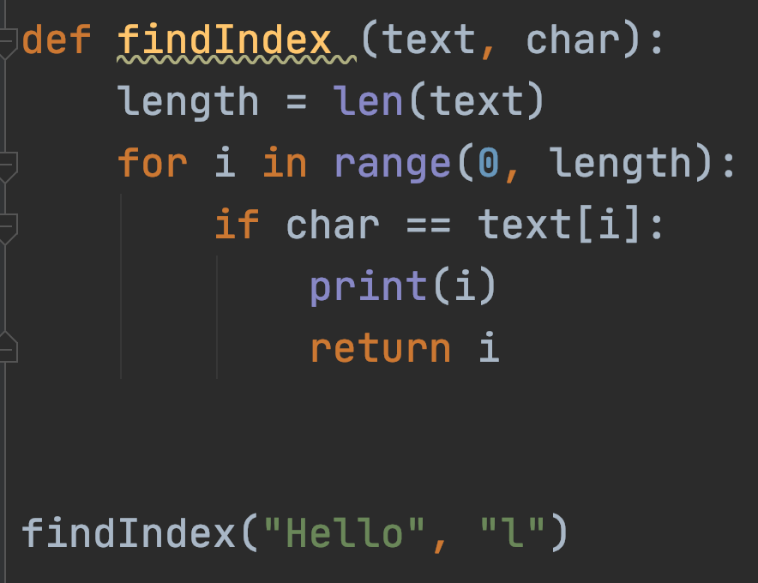
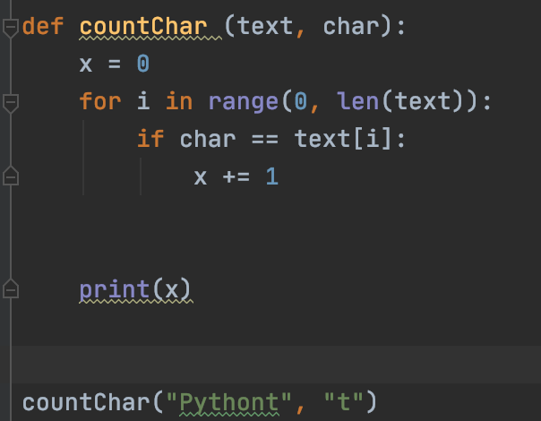
Custom index() and count() method
Index method has two variations, let’s make both of them
Count method to count how many times a character/substring occurs

Slide 13

Vowel counter
Takes a string as a parameter
Iterates through the whole string and counts how many vowels there are
Input: Hello
Output: 2
Homework: Make a consonant counter

Slide 14
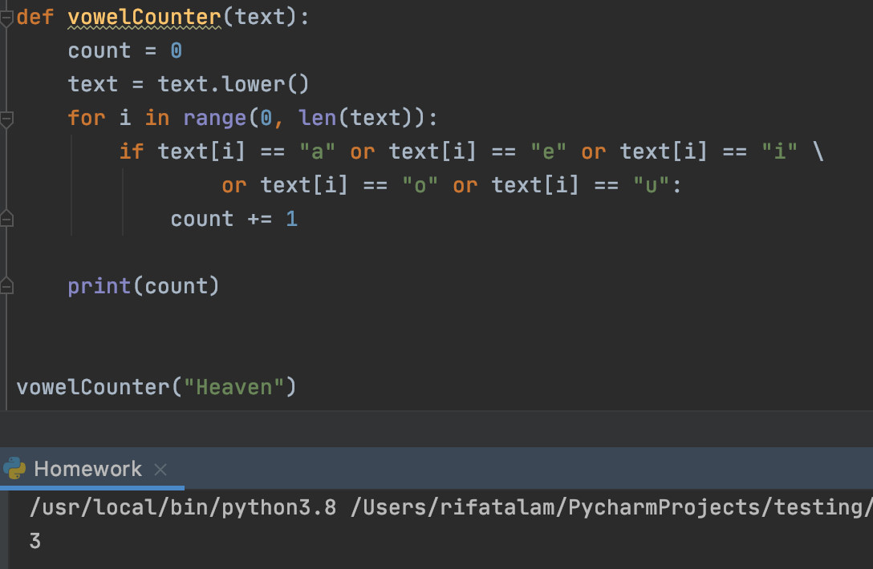
Solution

Slide 15
Tech Talk
https://youtu.be/X0XGure7mak
https://youtu.be/iwQRYzLZvGE
https://youtu.be/AI7M-JTC6_w - Ted Talk

